Slide 1
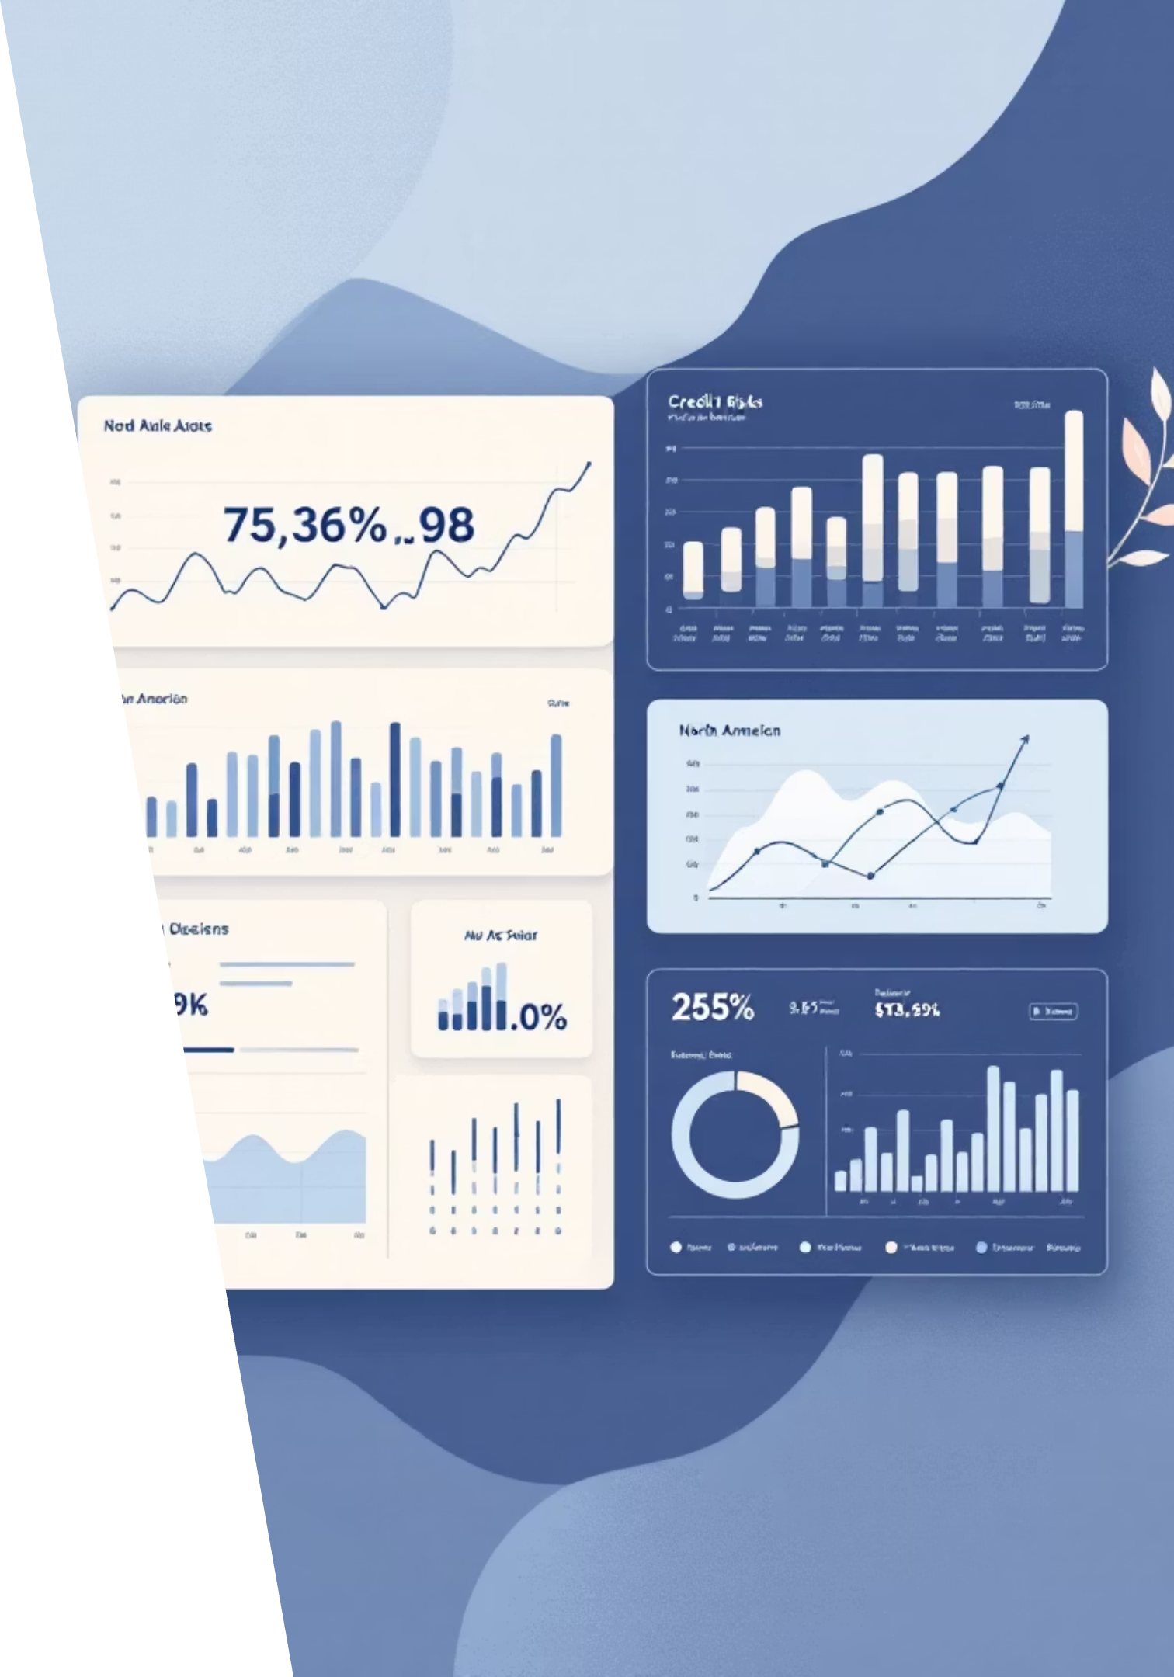
Understanding FICO: The Foundation of Modern Credit Scoring
Exploring how data analytics revolutionises credit risk assessment and transforms banking decisions across North America

Slide 2

What is FICO?
The Fair Isaac Corporation (FICO) pioneered credit scoring in 1956, creating the industry standard for assessing creditworthiness. FICO scores range from 300-850, with higher scores indicating lower credit risk.
Used by over 90% of top US lenders, FICO scores influence lending decisions for mortgages, credit cards, auto loans, and personal finance products across North America.
Source: Fair Isaac Corporation Annual Report 2023

Slide 3










How FICO Scoring Works
Credit Utilisation
Payment History
30% of score
35% of score
Percentage of available credit used
On-time payments and delinquencies
Credit History Length
15% of score
Age of oldest and average account
New Credit
10% of score
Credit Mix
Recent credit enquiries and accounts
10% of score
Variety of credit types managed
Source: FICO Score Methodology White Paper 2023

Slide 4

Data Analytics: Reducing Credit Risk
01
02
Data Collection
Predictive Modelling
Automated gathering from credit bureaus, banks, and alternative sources
Machine learning algorithms identify patterns and risk indicators
03
04
Risk Stratification
Decision Automation
Segmentation of borrowers into distinct risk categories
Real-time scoring enables instant lending decisions
Source: Federal Reserve Bank of Philadelphia, "Credit Scoring Models" 2023

Slide 5
Scale of Data
220M
40M
10B+
US Consumer Files
Canadian Consumers
Data Points
Credit profiles analysed monthly
Credit histories maintained
Processed annually across platforms
Sources: Experian, Equifax, TransUnion Annual Reports 2023

Slide 6




Advanced Analytical Methods
Machine Learning
Logistic Regression
Decision Trees
Neural networks identify complex patterns in borrower behaviour
Statistical models predict probability of default
Hierarchical algorithms segment risk categories
Source: Journal of Banking & Finance, "Modern Credit Scoring Techniques" 2023

Slide 7
Types of Data Analysed by FICO
1
2
3
Traditional Credit Data
Alternative Data Sources
Behavioural Analytics
Payment history across all accounts
Bank account transaction patterns
Credit application frequency
Account management behaviours
Account types and tenure
Employment and income verification
Spending patterns and seasonality
Outstanding balances and credit limits
Utility and telecommunications payments
Source: FICO Alternative Data Research Report 2023

Slide 8
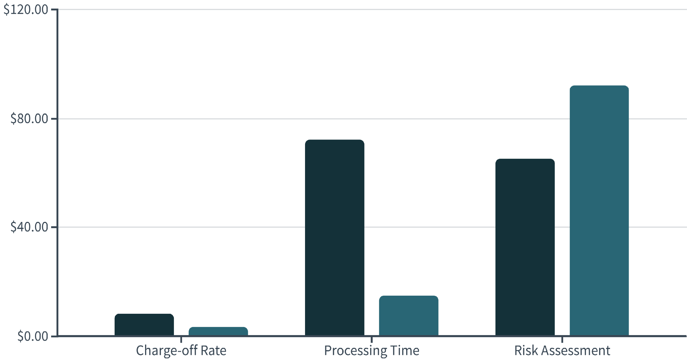
Effectiveness: Proven Results
Pre-FICO (1980s)
Post-FICO (2020s)
Source: Federal Deposit Insurance Corporation Historical Banking Data 2023

Slide 9



Banking Losses: Dramatic Reduction
58%
£2.1B
85%
Reduced Default Rates
Annual Savings
Faster Decisions
Average decrease in loan defaults since FICO implementation
Estimated loss prevention for UK banking sector
Reduction in loan processing time with automated scoring
Modern credit scoring has transformed banking profitability whilst expanding access to credit for qualified borrowers.
Source: Bank of England Financial Stability Report 2023

Slide 10



Future of Credit Scoring
AI Enhancement
Advanced neural networks processing real-time transaction data
Blockchain Integration
Secure, transparent credit histories across institutions
Open Banking
Comprehensive financial profiles with customer consent
Source: McKinsey Global Institute, "The Future of Financial Services" 2023

